Slide 1
Capstone Project PREDICTIVE & DESCRIPTIVE ANALYSIS ON SALES DATA
Name: Gurpreet Kaur
Student ID: 0776519
Supervisor’s Name: Savita Seharawat
Data analytics For Business | St. Clair College Ace Acumen

Slide 2
ABSTRACT:
We have selected Sales Data from sales datasets. This dataset includes about 40,000 records and 15 attributes. Each record corresponds to a customer information like (gender, education, house Value, age, region, fam income, region, marriage, children, occupation, car probability, house own, flag and. This dataset provide helps to organizations to better understand their customers needs and makes it easier for organizations to modify products according to the specific needs, behaviors, and interests of customers. When organizations satisfy customers specific needs according to their demands it helps companies to increase there productive of different products in the entire market and helps to gain more and more profit. This dataset is uncleaned there are some missing values in the dataset. It contains character and numerical data type. We will use some method to clean our dataset to make it stronger and more valuable to perform different types of models to collect different results.

Slide 3
RESEARCH QUESTIONS:
1. By predictive analysis find out whether the customer has bought the target product or not?
2. Find out how many consumers have online shopping experience and how many do not have online experience?
3. Find out total number of male and female in the dataset by descriptive analysis?
4. By predictive analysis find out which type of consumers increased the sales of products married and unmarried in the dataset?
5. Find out how many customers have highest and lowest family income?

Slide 4
Data Pre-processing
. Duplicate Values
In this dataset there are 55 duplicated values. These values are dropped from the dataset by using the drop duplicated command.
. Missing Values
Missing values in the dataset: There are total 18106 missing values in this dataset. In education attribute there are 735 null values, in House owner 3369 missing vales and in marriage attribute 14002 missing values. These values are filled by 0 for data cleaning.

Slide 5
Missing Values Table:
Missing Values | Count
education | 735
House owner | 3369
marriage | 14002

Slide 6
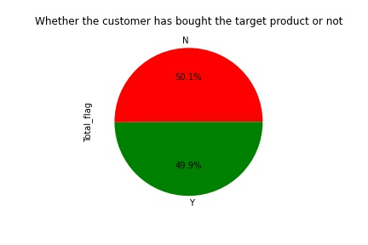
Distribution of Target Variable
It is clear from the pie chart that the percentage of both type customer who purchase their order product or who do not buy their products are almost same with small difference. As 50.1% customer received their order products and 49.9% do not bought their target products. So, from this percentage corresponding to both type customer its is predicted that company does not have more profit. As half of the count of total customer do not satisfy from the service of company because they do not buy their target product which they want to buy.

Slide 7
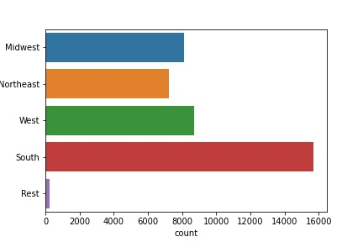
Region vs Customers Count
The highest count of customer belongs to south region that is 15676. The count of customers from Midwest and west almost same with small difference that is 8107 from Midwest and 8725 from west. The count of rest of region is 245.

Slide 8
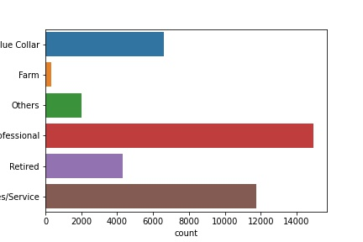
Occupation Vs Customers Count
As the highest count of customers count lies in the professional category that is 15000. the sales/service category is second highest category with 11500 counts of customers. In blue collar the count of customer is 6300 and the count of customers in in farm and others is lowest as compared to other four categories.

Slide 9
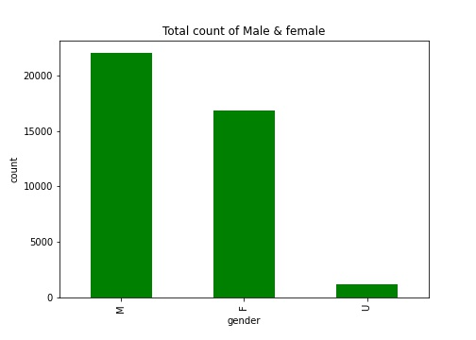
Find out total number of male and female in the dataset?
It is found that more male count included in sale of products as the count of male is highest (22500) as compared to other two categories female and unknown. Females have approximately
(17000) count in this dataset who bought the products which are on second position.

Slide 10
Experimental Design
Train-Test-Split Method
In train-test-split method the entire dataset is partitioned into training and testing sets. The training set contain 70% records and, in the testing, set it contain 30% records. Then I apply the under-sampling technique to balance the target variable.

Slide 11
Modelling
In the modelling part there are four methods Logistic Regression, KNN, Naive Bayes, random forest that I have applied on my dataset.
Column1 | Model | Train test split
0 | Logistic Regression | 66.59166667
1 | KNN | 56.98333333
2 | Naive Bayes | 43.06666667
3 | random forest | 66.20833333

Slide 12
Cross Validation:
K-Folds Cross Validation
The K-Folds technique Divide the dataset into k-folds in a series. At random, I divided the records into 5 folds. The four folds are then used for training part, and the fifth fold is used for testing. Repeat till each fold has been used as a take a look at set.
Stratified K Fold:
This pass-validation object returns stratified folds and is a variation of K-Fold. The folds are made by using preserving the share of samples in every class. I divided the data into 5 stratified folds. The 4 folds are then used to healthy the version, and the 5th fold is used to check it. Repeat until each fold has been used as a take a look at set.

Slide 13
Repeated Random Train-Test-Split
This method combines the k-fold-cross-validation approach with typical train-test-splits. I create random divides of the information in the training-check set, similar to the move-validation technique, and then repeat the procedure of splitting and trying out the algorithm many times. I divided the statistics into five Repeated Random Test-Train Splits.

Slide 14
Accuracy Matrix
Column1 | Model | Train test split | kfolds_5 | Stratifiedkfold_5 | RRTestTrainSplits_5
0 | Logistic Regression | 66.59166667 | 39.49689 | 55.20891182 | 56.0113852
1 | KNN | 56.98333333 | 11.13009 | 56.22795792 | 56.28842505
2 | Naive Bayes | 43.06666667 | 14.01036 | 54.53710675 | 54.08349146
3 | random forest | 66.20833333 | 50.48972 | 65.12576833 | 65.17267552

Slide 15
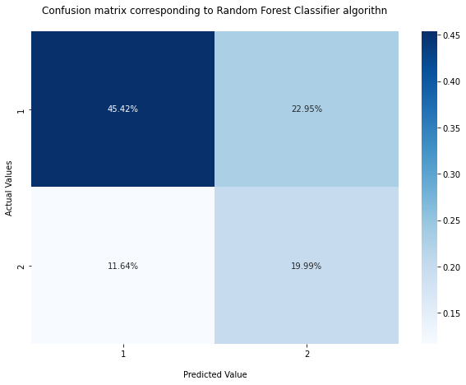
Confusion Matrix Corresponding to Random Forest Classifier Algorithm
When the target variable's actual value is 1 and the predicted value is also 1 and 45.42% of observation fall into first quadrant. 22.95% of observations fall into the second quadrant; whilst the target variable's actual value is 1 and predicted value is 2. 11.64 % of observations fall into the third quadrant; and while the target variable's actual value is 2 and predicted value 1, 19.99% of observations fall into the fourth quadrant. The actual and predicted values are each 2.

Slide 16
Classification Report
Column1 | precision | recall | f1-score | support
1 | 0.79 | 0.67 | 0.72 | 8193
2 | 0.46 | 0.63 | 0.53 | 3791
Precision - it shows the predicted value that are true cross ponding to target variable
Recall - it shows the actual value that are true cross ponding to target variable
F1 score – It is positive class in binary classification or weighted average of the f1 scores of each class for the multiclass task.

Slide 17
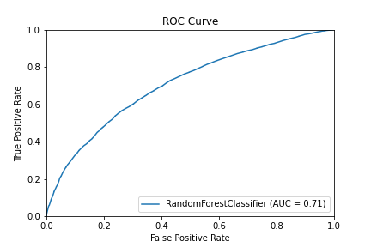
ROC Curve corresponding to the best fit model (Random Forest Classifier)
Receiver operating characteristics it is metric to evaluate classifier output quality. The area under curve is 0.71, it depicts that it is a perfect classifier.

Slide 18
Thank You

